Slide 1
Compensation And Benefit Re-structure for Agile Enterprise - a Psycho-Analytic study
Iraban,
Manager, Wipro Ltd.

Slide 2
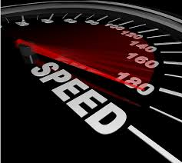
Protocol
For convenience of each of us, lets practice and adhere to followings during the session
Keep the mobile in silent mode
    In case of emergency, use the corridor to receive the call
Park the question to end of session
    Feel free to utilize Q&A session
Use the break time for additional queries
    Mail us for any further clarification

Slide 3
Agenda
Problem Statement
Detailed Historical Data Analysis
Solution Approach – Psycho-Analytic Survey
Solution Proposed and Practiced
Benefits & Key Take Away
Q & A

Slide 4
Problem Statement
Agile Practice Project Manager often face challenges like:
Synchronizing all staff at huddle meeting
Proactive participation in team for task distribution
On time task completion
Equal task distribution and normalization
Backup planning for task on critical situation
Impact of attrition on task
… the primary root cause is “Lack of Motivation”

Slide 5
Motivation – A Psycho-analytic study
Motivation:
  the inner strength to move towards some goal. (comes from Latin word: Movere – ‘To Move’)
  the process which initiate, drive & sustain behavior
Psychological Analysis Suggest:
  Incentive helps in achieving needs
Forms of Incentive:
  Rewards & Recognition
  Punishment & Negative reinforcement
  … Still challenge remains “How to Motivate to Deliver”

Slide 6
Detailed Historical Data Analysis
ACT
Pay Structure (Govt. Org)
Pay Structure (Pvt. Org)
1936 | 1948 | 1965
Payment of Wage | Minimum Wage | Bonus
4th Pay Comm. | 5th Pay Comm | 6 / 7th Pay Comm
3000-100-3500-125-4500 | 10000-325-15200 | 15600-39100 + grade pay 6600
Before 2001 | After 2001
All fixed salary | Performance linked variable salary introduced

Slide 7
Solution Approach – Psycho-Analytic Survey
Question Group
Methodology - Psychological Survey
  Understanding Employee Behavior
Question Bank – Preparation
  Four Groups
Targets for Survey
  To find the MOTIVE and Change Adaptation
Results Analysis
  84% of respondent looks for immediate rewords
  86% believes task based compensation increase perf.
Project Practice
Current CAB norm
Agile CAB prop
Individual Impact

Slide 8
SPEED …
SPEED – The need for change
Project Execution Model is heading towards Agile
Psycho-Analysis recommends immediate results
Faster GTM (Go-To-Market) drives the Business
Reward & punishment mechanism change aligning to Agile
Control for Manager for “Motivate to Deliver”
… “Power is nothing without control” – Pirelli

Slide 9
Solution Proposed and Practiced
SPEED (Superior Project-based Employee Engagement Design)
Tasks granularized to 4 hours effort.
Each task is associated with
  a complexity ratio number. (C_{n})
  a reward criterion. (R_{c})
  a penalty criterion. (P_{c})
Punctuality association with reward/penalty criterion. (T_{rp})
Knowledge sharing association with reward criterion. (K_{r})
Task outcome association with reward criterion. (T_{r})
Bonus for accumulating points based on range. (B_{r})

Slide 10
SPEED …
(Superior Project-based Employee Engagement Design)
SPEED
Formula used for cumulative points is:
C_{p} = ∑ (x * (C_{n} * [R_{c}-P_{c}] ) * T_{rp} + y * K_{r} + x * T_{r} ) * B_{r}
Where ‘x’ is number of task completed, &
‘y’ number of TT (Tech Talk Session)

Slide 11
Benefits & Key Take Away
Quantitative performance measurement
Team Technical strength Improvement for upcoming work
Good estimation accuracy and delivery forecast
Healthy competition among the team members
Team motivation, morale & attitude towards task completion
Reduced Attrition, increasing project performance

Slide 12

&
Q
A

Slide 13
Thank You
Contact Us at:
papers@pmibangalorechapter.org

Slide 14
Back-up Slide

Slide 15
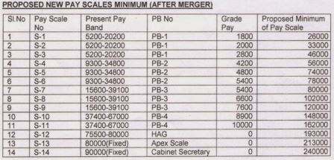
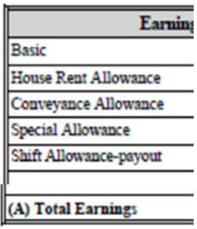
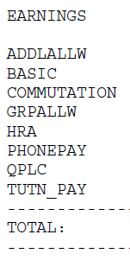
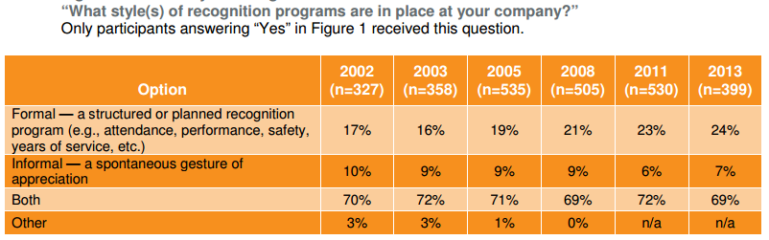
Reference Images
Fixed Salary (<2001)
7th Pay Commission Structure
Recognition Style Survey
Addition of Variable (>2001)

Slide 16
Survey Questionnaire

Slide 17
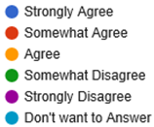
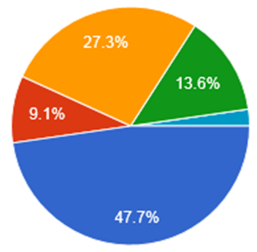
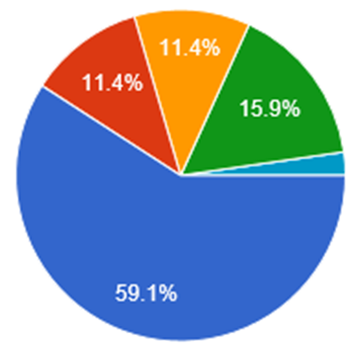
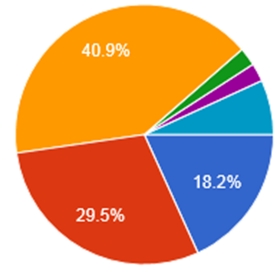
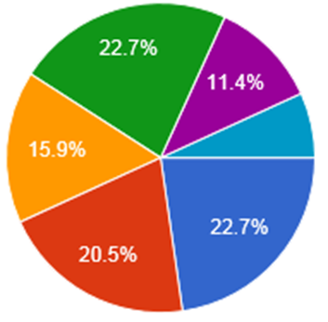
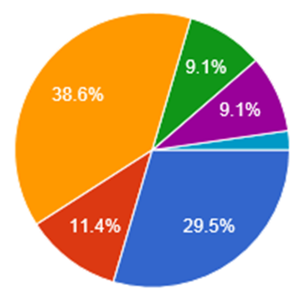
Section 1: Current Project Practice
I have experience in working with Agile project
I have experience in working with traditional /waterfall model
My organization use matrix structure for project resourcing
Employee motivation decision made by functional mgr & not project mgr
Yrly salary change & re-creational prog. are incentive methodology in my organization

Slide 18
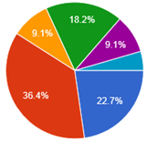
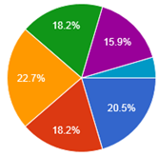
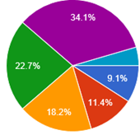
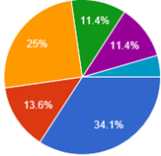
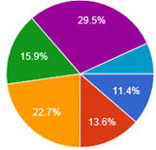
Section 2: Current org. CAB practice
My comp. decided by functional mgr & not my project mgr
My org increase comp. and gives bonus every financial yearl
My comp. varies based on the project model
I am satisfied with my current salary structure (BS + Allowance + Variable Component)
Financial increment motivates me in work place

Slide 19
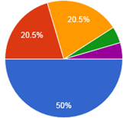
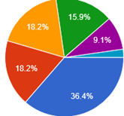
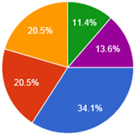
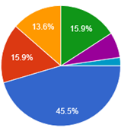
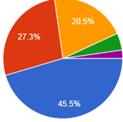
Section 3: Agile based CAB proposal
Incentive on task completion shall motivates me and increase my perf.
Preferably comp. to be revised by my Project mgr rather than functional mgr
I get motivated for reward on each task completion
Happy to have bonus on each milestone achievement
Risk & Reward prog. should be linked to my task completion

Slide 20
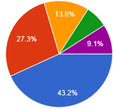
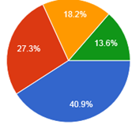
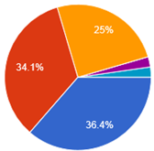
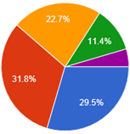
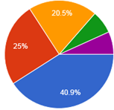
Section 4: Impact Analysis
Task based comp. shall increase the team performance
Intermediate increment and incentive shall reduce attrition
Immediate action on my work increase my performance
Volatile incentive based on task complexity shall increase the competitiveness
Incentive based task shall increase proactive participation in project

